Slide 1
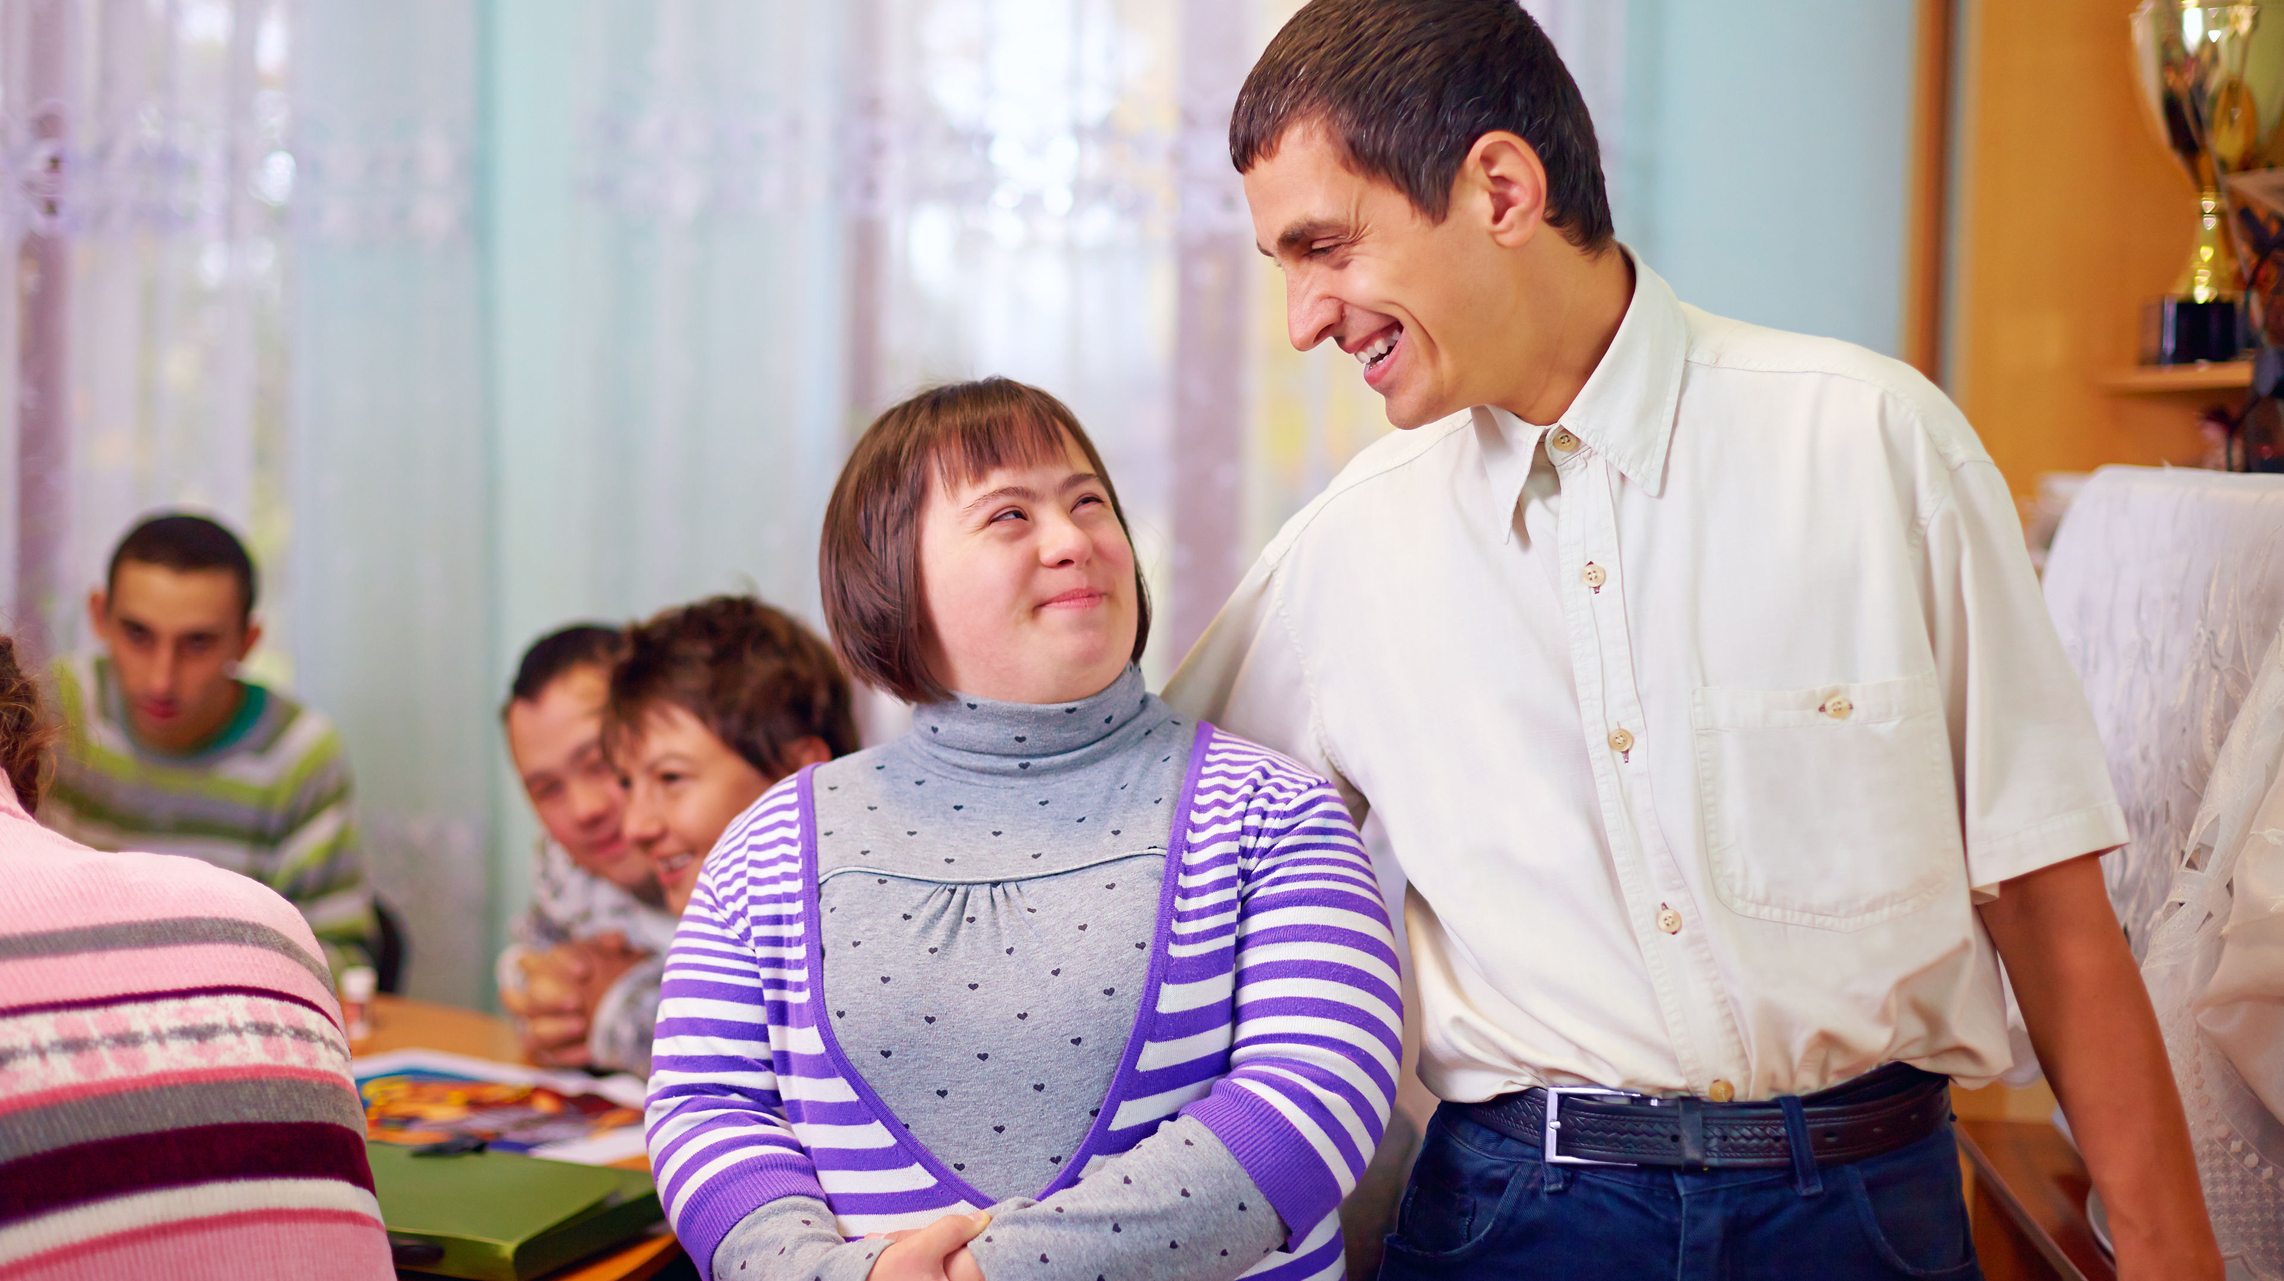
Work Within a Disability Support Context
CHCDIS020 - Work effectively in disability support (Release 1)

Slide 2



In order to effectively work within a disability support context, you must do the following:
Identify tasks in individualised plans
Use person-centred communication techniques when doing tasks
Seek consent from the person, carer, family, and others for support activities
Recognise and report signs of abuse
Record, maintain, and store workplace information
Work within a Disability Support Context

Slide 3

3.1
Identify Tasks in Individualised Plan

Slide 4

Individualised plans (care plans or support plans) are written documents that contain information relevant to the person’s care and support.
Work within a Disability Support Context

Slide 5
The Purpose of Individualised Plans
When engaging in ADLs, you must remember to adopt a person-centred approach.
It is essential to review individualised plans to keep in mind the person’s needs, strengths, capabilities, and preferences.
PWDs, as individuals, have their own needs, strengths, capabilities, and preferences.
These are established in individualised support plans.
Work within a Disability Support Context

Slide 6

Person-centred planning meetings involve the PWD and their family and carers to identify the person’s needs and goals.
Individualised plans require regular review in consultation with the PWD and their family and carers.
Support staff must monitor these changes immediately and report them as per the organisation’s policies and procedures.
Work within a Disability Support Context

Slide 7
One factor that can influence the content of individualised plans is the type of disability and functional capacity.
A disability hinders the person from performing everyday activities. Meanwhile, functional capacity is measured by how well someone can perform everyday activities.
To identify tasks in individualised plans, you must first understand the types of disability that you may come across.
Different disabilities have different needs, and what applies to one patient may not be relevant to another.
Work within a Disability Support Context

Slide 8
These are the types of disability discussed in this chapter:
Neurological impairment
Psychosocial disability
Work within a Disability Support Context

Slide 9
Neurological Impairment
Refers to any abnormalities in the brain, spinal cord, or other parts of the nervous system. Symptoms of neurological impairment include the following:
Physical weakness, paralysis, or loss of sensation
Poor coordination or confusion
Seizures
Pain
Work within a Disability Support Context

Slide 10
Neurological impairment covers a wide range of disabilities, including the following:
Acquired Brain Injury
Autism Spectrum Disorder
Learning Disability
Intellectual Disability
Physical Disability
Sensory Disability
Speech/Language Disability
Developmental Delay
Work within a Disability Support Context

Slide 11
Psychosocial Disability (PSD)
It refers to a disability that may have been caused by a mental health issue. A person living with a mental health condition may negatively impact how they function. This involves experiencing social barriers which creates inequality between the person and others.
Work within a Disability Support Context

Slide 12
Examples of PSD are:
Anxiety disorders
e.g. obsessive-compulsive disorder (OCD)
Mood disorders
e.g. depression
Schizoid disorders
e.g. schizophrenia
Work within a Disability Support Context

Slide 13
PSD may impact the person’s ability to:
Focus
Cope with stress
Manage multiple tasks and cope with time
Socialise with other people
Work within a Disability Support Context

Slide 14
PSD may impact the person’s ability to:
Take feedback constructively
Function in specific types of environments
Have enough motivation and energy to finish tasks
Work within a Disability Support Context

Slide 15
Different between psychosocial disability (PSD) and mental health:
Psychosocial disability is not a diagnosis but a term to describe the functional effects, obstacles or barriers to equality experienced by a person with mental health condition as they interact with a social environment.
On the other hand, mental health refers to the general state of wellbeing that affects a person's confidence, self-esteem, their ability to cope and contribute to their community.
Work within a Disability Support Context

Slide 16
Difference of psychosocial disability and mental condition:
Psychosocial Disability | Mental Health Condition
It focuses on the impact (i.e. disability) brought about by the disorder. | It refers to disorders affecting someone’s cognition, perception, emotional regulation and behaviour.
Work within a Disability Support Context

Slide 17
In essence, a mental health condition is also considered a PSD when it becomes a barrier to the person’s equality with other people. Some people with mental health conditions may experience challenges related to their condition, but this will not affect their ability to concentrate, complete tasks, cope with stressful situations, interact with others, manage stress or accept constructive feedback.
Work within a Disability Support Context

Slide 18
PSD is episodic in nature. This means that:
A person living with PSD may fluctuate between being well and experiencing the disability
The length, degree and triggers may also be unpredictable
Needed support will vary from person to person
Work within a Disability Support Context

Slide 19

The following example is given to better illustrate additional and alternative support better:
Bipolar disorder is a mental health condition common to people with disability that is associated with a psychosocial disability. It has two phases: manic episode and depressive episode.
Work within a Disability Support Context

Slide 20
Manic episode is a period of at least one week during which a person has more energy than normal, is extremely elated or agitated most of the time, and exhibits at least three of the behavioural changes listed below:
Decreased need for sleep
Increased or faster speech
Uncontrollable racing thoughts
Distractibility
Increased activity
Increased risk behaviour
Work within a Disability Support Context

Slide 21
Below are examples of support that can be given to the person during this phase:
Additional support
Alternative support
Introduce relaxation strategies to the person
Educate the person’s carer about the relaxation strategies that they can assist the person in doing when they have manic episodes
Work within a Disability Support Context

Slide 22
Depressive episode is a period of at least two weeks during which a person has at least five of the following symptoms (including at least one of the first two symptoms):
Intense sadness or despair
Loss of interest in activities
Feelings of worthlessness
Feelings of guilt
Fatigue
Increased or decreased sleep
Work within a Disability Support Context

Slide 23
Depressive episode is a period of at least two weeks during which a person has at least five of the following symptoms (including at least one of the first two symptoms):
Increased or decreased appetite
Restlessness
Slowed speech or movement
Difficulty concentrating
Frequent thoughts of death
Frequent thoughts of suicide
Work within a Disability Support Context

Slide 24
Below are examples of support that can be given to the person during this phase:
Additional support
Alternative support
Encourage the person to join social activities in their local community
Provide a list of same-interest groups that the person can participate to make connections with people who have similar or shared experiences
Work within a Disability Support Context

Slide 25
Below are examples of how other disabilities contribute to PSD:
PSD and sensory disability
Examples of sensory disability include blindness and deafness. People living with a sensory disability impact their communication and learning skills.
PSD and physical disability
Examples of physical disability include spinal cord injuries and cerebral palsy. People living with physical disability experience a lot of barriers.
Work within a Disability Support Context

Slide 26
Below are examples of how other disabilities contribute to PSD:
PSD and intellectual disability
Intellectual disability is characterised by significantly low cognitive skills compared to what is expected at a certain level. This may affect the person’s social, communication and self-care skills.
Work within a Disability Support Context

Slide 27

How to Read an Individualised Plan
You can identify your tasks and determine how to carry them out by familiarising yourself with the individualised plan’s contents.
Individualised plans across organisations vary greatly, but there are contents that are essential to all plans.
Work within a Disability Support Context

Slide 28
Essential contents in individualised plans across organisations:
The person’s basic information (name, history, condition, and allergies, if any)
The person’s holistic needs (physical, emotional, psychological, and spiritual)
The person’s wants and preferences
The person’s goals in terms of their holistic needs
The person’s support schedule (including tasks, frequency of tasks, and equipment needed)
Work within a Disability Support Context

Slide 29
Essential contents in individualised plans across organisations:
Sources of funding for the person’s needs and the total budget for these
Strategies for supporting and empowering the person to meet their holistic needs
The person’s behaviour(s) of concern, if any
Other information such as medication and the specialist personnel to contact when the need arises
Work within a Disability Support Context

Slide 30
Understanding Individualised Plans Through Social Role Valorisation
Social role valorisation (SRV) is the idea that the more society perceives someone’s role as ‘valuable’, the more likely that person will experience ‘good things in life’.
‘Good things’ can mean acceptance, respect, education, inclusion, and opportunities to develop one’s capacities.
The goal of SRV is to create socially valuable roles for people in society.
Work within a Disability Support Context

Slide 31

SRV is relevant to two types of people:
People who are socially devalued
People who are about to be socially devalued
Work within a Disability Support Context

Slide 32
Devalued members have an increased likelihood of being mistreated by:
Being perceived as someone who does not meet society standards
Being rejected by society
Being cast into a negative role (e.g., a ‘burden’ on society)
Being segregated from others
Having prejudices and stereotypes attached to them
Being an object of abuse and violence
Work within a Disability Support Context

Slide 33
The SRV can help shape the way individualised plans are developed and carried out.
This is done in the following ways:
Based on the information gathered from the person, they will name the roles they currently have and the roles they want.
With the roles in mind, an individualised plan can have a list of suitable goals for the person to reach.
Specific plans can be made based on the goals indicated.
Work within a Disability Support Context

Slide 34

3.2
Use Person-Centred Communication Techniques When Doing Tasks

Slide 35
When working in disability support, you need to apply person-centred communication techniques to show respect for the person’s rights and dignity.
Before learning about these techniques, you must first be familiar with key philosophies and concepts.
These concepts will inform you how to conduct yourself and engage with the person.
Work within a Disability Support Context

Slide 36
3.2.1 Contemporary Views, Philosophies, and Concepts in Disability Support
Contemporary Views on Disability Support
Over the years, views on disability and disability support have changed.
Previously, disabilities were seen as problems to be fixed. Now, disabilities are seen as caused by the lack of an inclusive society.
Service providers had ultimate control over the person’s care, but now, contemporary approaches emphasise the individual's place at the centre of their care.
Work within a Disability Support Context

Slide 37

Models of Disability
Two models of disability:
Medical model
Social model
Each model provides a framework of how disability support services are designed and delivered.
Work within a Disability Support Context

Slide 38
Here is a graphic comparing the medical model with the social model:
Disabilities are problems to be fixed
Social Model
Focuses on their capabilities
Focuses on what is 'wrong'
Loss of independence
Disabilities are caused by the way society lacks inclusion
Respect for individual autonomy and self-determination
Medical Model
Work within a Disability Support Context

Slide 39
Empowerment of Person Receiving Support
Empowerment means promoting and encouraging self-determination by PWDs.
This means supporting them to make their own choices and decisions.
Empowerment involves giving the PWD the skills, resources, and motivation to meet their needs and goals.
It also means that the person is held responsible and accountable for the outcomes of their actions.
Work within a Disability Support Context

Slide 40
Your approach must be based on your responsibilities and the needs of the people you will be working with. Your approach will also reflect your values and attitudes.
As you develop your approach, you must ensure that:
You have the proper personal values and attitudes for assisting PWDs
Your approach will address all your job responsibilities
Your approach values the safety of the PWD
Work within a Disability Support Context

Slide 41
As you develop your approach, you must ensure that:
Your approach provides the immediate needs of the PWD and, at the same time, assists them in developing the skills or behaviours they need for the future
Your approach allows you to be flexible and capable of adapting to various situations
Your approach involves elements of communication that are appropriate to your role
You take into consideration the different legal and ethical considerations relevant to your role
Work within a Disability Support Context

Slide 42
Trauma-informed Practice
When providing disability support to a person, support workers should be guided by trauma-informed practice. It is an approach that aims to understand and respond to the effects of trauma on a person. It recognises that trauma can impact the psychological, social and emotional wellbeing of a person. It intends to foster a safe environment and empower the person in order to overcome or manage the effects of trauma in their lives.
Work within a Disability Support Context

Slide 43
Trauma-informed practice is grounded in the following principles:
Safety
Trust
Promotes a safe and welcoming environment for processing traumatic experiences
Promotes that services offered should be sensitive to the person’s need
Advocates for transparency when providing services.
Work within a Disability Support Context

Slide 44
Trauma-informed practice is grounded in the following principles:
Choice
Promotes the opportunity for choice
Collaboration
Promotes working together with the person and not just commanding them
Work within a Disability Support Context

Slide 45
Trauma-informed practice is grounded in the following principles:
Empowerment
Respect for diversity
Promotes having practices that empower the person
Promotes respect towards the person, including their culture, gender and background
Work within a Disability Support Context

Slide 46
Trauma-informed practice can be divided intro four stages. The following are the stages:
Trauma aware
During this stage, the service provider understands the trauma of the person. They also determine the effects of the trauma and how the person reacts and copes with those effects.
Trauma sensitive
During this stage, the service provider integrates trauma-related concepts to their practice. This aims to cater to the needs of the person.
Work within a Disability Support Context

Slide 47
Trauma-informed practice can be divided intro four stages. The following are the stages:
Trauma responsive
During this stage, the service provider implements action plans to address the effects of trauma in the person’s life. This may entail changing, modifying or strengthening behaviours.
Trauma-informed
During this stage, the organisation reflects a trauma-informed approach in workplace policies, procedures and practices.
Work within a Disability Support Context

Slide 48
Here are some guidelines for integrating trauma-informed practices in disability support:
Seek understanding on the relationship between disability and trauma (e.g. how the person’s trauma impacts their disability and vice versa).
Equip staff with the relevant knowledge on trauma.
Train staff on how to carry out trauma-informed workplace practices.
Work within a Disability Support Context

Slide 49
Here are some guidelines for integrating trauma-informed practices in disability support:
Build trust with the person with disability.
Address the barriers to accessing relevant services.
Obtain feedback and use that to improve workplace practices.
Record successful practices and promote their implementation.
Work within a Disability Support Context

Slide 50
Social and Emotional Well-being Frameworks
Social emotions are your emotions that depend upon the thoughts, feelings, or actions of other people. Examples of these are:
Embarrassment
Grief
Shame
Empathy
Pride
Work within a Disability Support Context

Slide 51
According to the World Health Organization (WHO), social and emotional well-being are closely related to the concept of mental health. A person with stable mental health has the capacity to do the following: Build trust with the person with disability.
Can realise own abilities
Can cope with the everyday stresses of life
Can work productively
Can contribute to the community
Work within a Disability Support Context

Slide 52
A person with disability achieves good mental, social and emotional well-being when their needs relevant to building relationships and emotional fulfilment are met and when distress arising from unmet needs in other domains are minimised. The other domains include the following:
Physical domain
Informational domain
Practical domain
Spiritual domain
Work within a Disability Support Context

Slide 53
These domains may be affected by different types of disability, which may include the following:
Intellectual
Physical
Acquired brain injury
Neurological
Dual sensory
Work within a Disability Support Context

Slide 54
These domains may be affected by different types of disability, which may include the following:
Vision
Hearing
Speech
Psychiatric
Developmental delay
Work within a Disability Support Context

Slide 55
These categorisations of disabilities are influenced by the following factors:
Underlying health conditions
Impairments
Activity limitations
Restrictions on participation
Work within a Disability Support Context

Slide 56
Your client’s social and emotional well-being is essential. It promotes the social and emotional relationships between them, their families and their community.
When your client develops a sense of belonging to the community and the ability to handle their own emotions, they can build confidence and higher self-esteem.
Work within a Disability Support Context

Slide 57

Examples of frameworks you can use to help your client with their social and emotional wellbeing are:
Australia’s Disability Strategy 2021–2031
Disability Gateway
Psychosocial Recovery-Oriented Framework
Work within a Disability Support Context

Slide 58
3.2.2 Identifying Person-Centred Approaches and Effective Risk Assessment Strategies
Person-Centred Approaches
Person-centredness means putting the person in the centre of care delivery. All actions and decisions about their care will be based on what they need and want.
In a care setting, a person-centred approach means treating a person with compassion, dignity, and respect by using appropriate care strategies and having policies and procedures that support the person’s choice.
Work within a Disability Support Context

Slide 59

It is critical to provide person-centred services because they allow a carer or support worker to uphold the rights of PWDs.
Applying person-centred approaches assists in making the person happier.
Work within a Disability Support Context

Slide 60
Person-centred approach has the following benefits:
PWDs will have an easier time trusting those who apply person-centred approaches.
PWDs will be more compliant with routines, activities, and programs designed based on their needs and wants.
It will be easier to create support strategies or complicated care procedures.
You will not need to spend a lot of time and effort managing the person’s behaviour and convincing them to take part in certain activities.
Work within a Disability Support Context

Slide 61

You must do the following to deliver person-centred services:
Ensure the rights of the person are upheld.
Ensure the needs of the person are upheld.
Work within a Disability Support Context

Slide 62
Risk Assessment Framework
Another specific instance is when a disability support worker works with a risk assessment framework.
In the context of disability support, risk assessment is the evaluation of potential risks that may affect the person you are caring for.
Work within a Disability Support Context

Slide 63
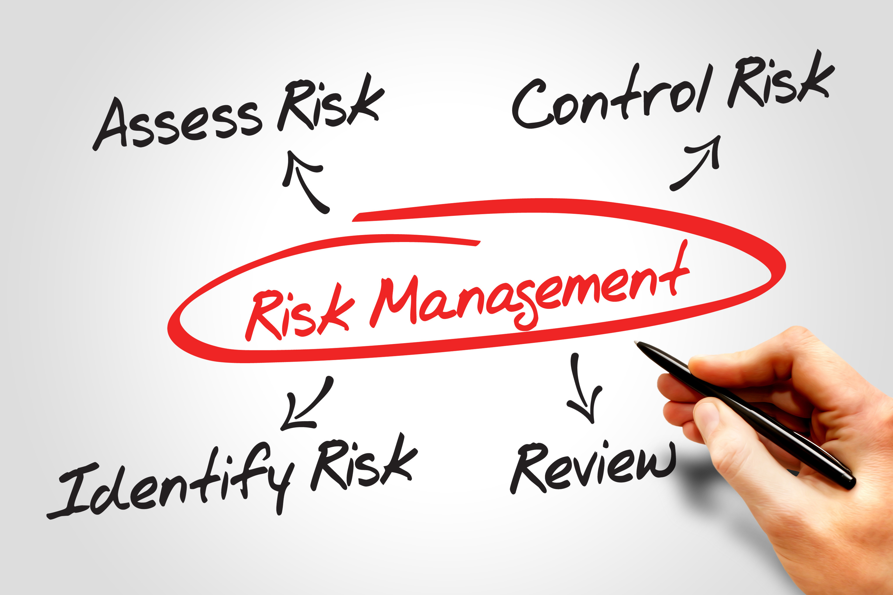
Effective risk management means considering risks and hazards while upholding certain values.
These are values of autonomy, choice, self-determination, and other person-centred approaches.
Work within a Disability Support Context

Slide 64
The following are criteria you can consider when conducting an effective risk assessment:
Involvement of the Person and Their Family or Carers
Proportionality
Positive and Informed Risk-Taking
Work within a Disability Support Context

Slide 65
The following are criteria you can consider when conducting an effective risk assessment:
Contextualisation of Behaviour
Defensible Decision-Making
Tolerable Risks
Learning Culture
Work within a Disability Support Context

Slide 66
Keep these criteria in mind as you go through the three different phases of risk assessment.
The graphic below details these phases:
Information Gathering and Assessment
Planning
Monitoring and Review
Work within a Disability Support Context

Slide 67
Three phases of risk assessment:
Informational Gathering and Assessment
You must contextualise risk assessment and understand the person before engaging in the risk assessment proper.
You must gather information from the person, their carer, family, and others to assess properly.
Work within a Disability Support Context

Slide 68
Three phases of risk assessment:
Planning
After gathering the necessary data, you can now plan how to manage the risk.
Risk assessment frameworks may already be put in place in the person’s individualised plan, which you must note while doing tasks.
Work within a Disability Support Context

Slide 69
The following are possible occasions on when you may perform risk assessment:
Personal Worker Care Role
Working in a Person’s Home
Assisting a Person to Engage Outside of Their Regular Setting
Planning an Activity
Medication
Work within a Disability Support Context

Slide 70
Three phases of risk assessment:
Monitoring and Review
As you take measures to minimise risk, make sure to record what has taken place.
The record includes which risks and hazards wereinvolved, what action was taken, and the result.
Work within a Disability Support Context

Slide 71
Three phases of risk assessment:
Monitoring and Review
You will need this data to:
Record what actions worked or created a new hazard
Have a document trail detailing the justifications for the actions that took place
Prepare for the next instance risk needs to be assessed.
Work within a Disability Support Context

Slide 72
3.2.3 Applying Person-Centred Communication Techniques
Person-centred communication techniques are methods where you use person-centred approaches for effective communication.
In this section, you will learn about three techniques:
Collaboration
Confrontation
Motivational Interviewing
Work within a Disability Support Context

Slide 73
Collaboration
This is an approach that is concerned with both parties in a conversation.
The goal of this approach is to have a win-win solution.
Collaboration helps in resolving constraints in communication by considering the ideas and opinions of both ends.
Work within a Disability Support Context

Slide 74

Confrontation
This refers to an approach wherein you directly tell a person your feelings and emotions and what you want to happen when there is a face-to-face encounter.
This approach is challenging because there is a high chance for that person to feel upset or disappointed.
Work within a Disability Support Context

Slide 75
Below are example steps on how confrontation can be done:
Prepare
Invite the Person
State the Facts
Control Your Emotions
Resolve
Work within a Disability Support Context

Slide 76
Motivational Interviewing
A popular technique used in disability support is known as motivational interviewing.
A person-centred communication technique where one can:
Make clarifications about statements
Build confidence in the person
Motivate the person to keep positive habits and make positive changes
Work within a Disability Support Context

Slide 77

Motivational interviewing will help in resolving constraints to communication.
They will be given autonomy to learn from their own mistakes.
This will encourage them to realise what they need to do in solving their difficulties.
Work within a Disability Support Context

Slide 78
In contrast, there is a method known as the coercive approach which is forcing someone to make a change, often a behavioural one.
This is less effective in resolving constraints in communication where the people will not be given the free will to learn from their own mistakes.
They will be forced to follow communication norms that may not align with their strategies as well as their beliefs.
Work within a Disability Support Context

Slide 79
The following are tools involved in motivational interviews:
Open-Ended Questions
Affirmations
Reflections
Summaries
Work within a Disability Support Context

Slide 80

3.3
Seek Consent From the Person, Carer, Family, and Others for Support Activities

Slide 81
The person has their preferences, priorities, needs and goals in which they may want to be more independent when it comes to one support activity.
They may want the carer to carry out a specific support activity instead.
They must also be given the freedom to carry out how this is done. This is to respect the individual’s rights and apply a person-centred approach to their care.
Work within a Disability Support Context

Slide 82
Who Can Give Consent
Person ̶ The principal person who will be giving consent.
Family, Carer, and Others ̶ If the person is unable to give consent, substitute decision-making has to be done. These must come from legally appointed persons.
Work within a Disability Support Context

Slide 83

The following are the possible instances of when a person may be unable to consent:
They are not of legal age.
Medical conditions render the person incapacitated.
Other situations when the person cannot consent even with support.
Work within a Disability Support Context

Slide 84
How to Seek Consent
When seeking consent from the person, carer, family, or others, make sure that all aspects of consent are fulfilled.
Consent must be:
Voluntary
Informed
Specific
Current
Work within a Disability Support Context

Slide 85
As much as possible, ensure that consent is expressed.
Make sure that the person clearly and directly gives their consent in verbal or written form.
Written consent is preferred so that all parties involved can refer to it later. It would also serve as proof that the person consented to the activity.
Work within a Disability Support Context

Slide 86

The following are possible written forms of consent:
Consent form
Notes and remarks in healthcare records
Listed support activities in the individualised plan
Work within a Disability Support Context

Slide 87
Encourage open communication with the person, carer, family, and others.
Always inform them about what support activity you will be doing.
Remind them that they can change their mind about what support activities they consented to.
Work within a Disability Support Context

Slide 88
Aside from fulfilling all aspects of consent, you must also do the following:
Inform them of their right to consent or withdraw consent.
Consider the level of understanding of the person. Avoid jargon and make sure to clarify anything confusing or unclear.
Give the person time to process information and decide.
Consider culture and language barriers. You may seek a cultural liaison or interpreter, if necessary.
Work within a Disability Support Context

Slide 89

3.4
Recognise and Report Signs of Abuse

Slide 90
Abuse refers to all acts that cause physical, sexual, or mental injuries to a person.
On the other hand, neglect refers to inactions that also cause the same injuries.
Abuse and neglect are serious offences that affect people of all ages, with and without disabilities.
Work within a Disability Support Context

Slide 91
Several risk factors lead to increased abuse of PWDs. These factors make PWDs more likely to be the victims of abuse. These risk factors include the following:
Lack of knowledge of individual rights as a PWD
Lack of training of staff in recognising and reporting abuse
Work within a Disability Support Context

Slide 92
A systemic issue is a problem that results from a system in place. This means it is not a result of an individual factor.
In disability support, systemic issues can result from the following::
Poor funding of care services
Inadequate protection for PWDs
Work within a Disability Support Context

Slide 93
Recognising Signs of Abuse
As a disability support worker, you can look out for the indicators of abuse in the following table:
Types of Abuse | Description
Physical Abuse | These are actions that involve the inappropriate use of physical contact or force against a person.
Work within a Disability Support Context

Slide 94
As a disability support worker, you can look out for the indicators of abuse in the following table:
Types of Abuse | Description
Emotional Abuse | These are actions or behaviours that reject, isolate, intimidate or frighten by threats, or the witnessing of family violence, to the extent that the person’s behaviour is disturbed or their emotional/psychological well-being has been or is at risk of being seriously impaired.
Work within a Disability Support Context

Slide 95
As a disability support worker, you can look out for the indicators of abuse in the following table:
Types of Abuse | Description
Financial Abuse | This involves the misuse of a person’s assets, property, possessions and finances without their consent.
Sexual Abuse | This involves actual or attempted unwanted sexual actions that are otherwise forced on a person with disability against their will or without their consent through the use of physical force, intimidation or coercion.
Work within a Disability Support Context

Slide 96
Reporting Signs of Abuse
Your organisation will follow state or territory procedures for reporting cases of abuse and neglect. The following information, for example, is relevant to people in Queensland:
Types of Abuse Cases | Procedure for Reporting
Domestic and Family Abuse | Phone Triple Zero (000) for emergency situations Phone Policelink on 13 14 44 for non-emergency situations
Work within a Disability Support Context

Slide 97
Your organisation will follow state or territory procedures for reporting cases of abuse and neglect. The following information, for example, is relevant to people in Queensland:
Types of Abuse Cases | Procedure for Reporting
Domestic and Family Abuse | Make a non-urgent report of DFV by submitting an online form. Phone DVConnect on 1800 811 811 if you are escaping DFV and need a place of safety. Access the Domestic and Family Violence Portal.
Work within a Disability Support Context

Slide 98
Your organisation will follow state or territory procedures for reporting cases of abuse and neglect. The following information, for example, is relevant to people in Queensland:
Types of Abuse Cases | Procedure for Reporting
Child Abuse and Neglect | Phone Triple Zero (000) for emergency situations Contact the following for non-emergency situations: Regional Intake Service Child Safety After Hours Service Centre on 1800 177 135
Work within a Disability Support Context

Slide 99
Your organisation will follow state or territory procedures for reporting cases of abuse and neglect. The following information, for example, is relevant to people in Queensland:
Types of Abuse Cases | Procedure for Reporting
Child Sexual Abuse | Contact the following: Child Safety Services on 13 QGOV (13 74 68) Child Safety After Hours Service Centre on 1800 177 135 outside business hours
Work within a Disability Support Context

Slide 100
Your organisation will follow state or territory procedures for reporting cases of abuse and neglect. The following information, for example, is relevant to people in Queensland:
Types of Abuse Cases | Procedure for Reporting
Child Sexual Abuse | Contact the following: Your local police station about criminal matters related to child sexual abuse ChildWise National Child Abuse Prevention Helpline on 1800 991 099
Work within a Disability Support Context

Slide 101
Your organisation will follow state or territory procedures for reporting cases of abuse and neglect. The following information, for example, is relevant to people in Queensland:
Types of Abuse Cases | Procedure for Reporting
Sexual Violence | Phone Triple Zero (000) for emergency situations Contact the Sexual Assault Helpline on 1800 010 120 for counselling and referral. Use the Alternative Reporting Option (ARO)
Work within a Disability Support Context

Slide 102
Your organisation will follow state or territory procedures for reporting cases of abuse and neglect. The following information, for example, is relevant to people in Queensland:
Types of Abuse Cases | Procedure for Reporting
Elder Abuse | Call the Elder Abuse Helpline (phone 1300 651 192 for Queensland or (07) 3867 2525 for the rest of Australia). Seek help from a local DFV support service
Work within a Disability Support Context

Slide 103
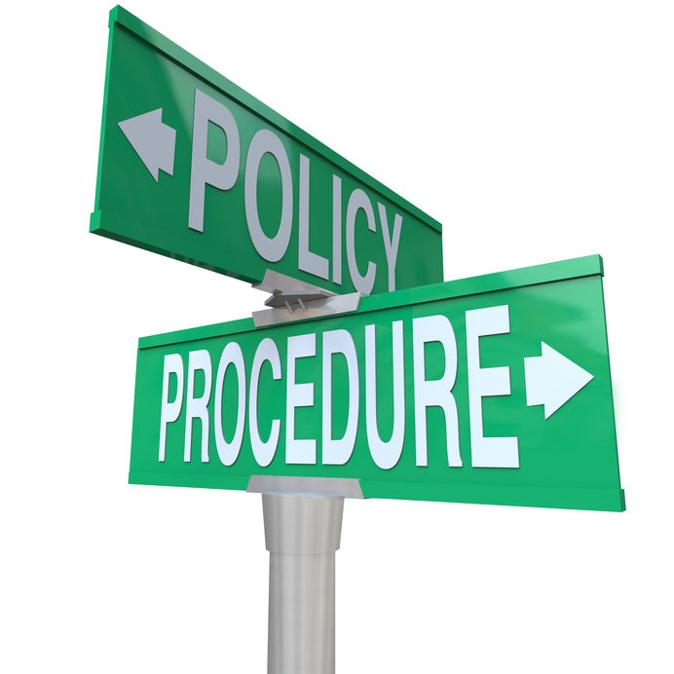
3.5 Record, Maintain, and Store Workplace Information

Slide 104
3.5.1 Record-Keeping Workplace Information
Workplace Information and Documents
Workplace documents are an essential part of the organisation.
These are used to communicate information, implement policies and procedures, record information and more.
Care and support service providers also have protocols and procedures for completing workplace documentation.
Work within a Disability Support Context

Slide 105
Protocols and procedures for completing workplace documentation:
Privacy and Confidentiality
Organisational Style Guides and Templates
Mandatory Reporting
Emails
Record-Keeping and Management
Work within a Disability Support Context

Slide 106

Disability support workers complete tasks with the guidance of workplace documents including the position descriptions and individualised care plans or support plans.
Most likely, record-keeping and management may be part of your day-to-day tasks, depending on the specific tasks assigned to you.
Work within a Disability Support Context

Slide 107
Record-Keeping Workplace Information
Record-keeping involves accurately tracking the activities occurring within an organisation.
Efficient record-keeping and management benefit medical practices since they improve your daily operations.
Other benefits include securing confidential files and ensuring consistency across the organisation.
Work within a Disability Support Context

Slide 108
As a disability support worker, you need to make sure that you keep records reliably. You can follow this process to do that:
Record any information about the support services provided as soon as they are collected.
Review records to identify information that should be clarified, expanded or explained.
Work within a Disability Support Context

Slide 109
As a disability support worker, you need to make sure that you keep records reliably. You can follow this process to do that:
Clarify, expand or explain information about the support services provided as necessary.
Ensure that everyone who will access and use the records can answer them.
Work within a Disability Support Context

Slide 110
Record-keeping should be done in compliance with the National Disability Insurance Scheme Act 2013, NDIS Rules and Terms of Business. You must keep records of all the support you have given. You should always keep these in your records:
Support services that were delivered and not delivered
Date and time when and the place where the support services are delivered
Manner of receiving the services as intended by the person
Comments or concerns raised about the services provided
Work within a Disability Support Context

Slide 111
Record-keeping should be done in compliance with the National Disability Insurance Scheme Act 2013, NDIS Rules and Terms of Business. You must keep records of all the support you have given. You should always keep these in your records:
Recording of the status of achieving the goals of the services
Changes in how the person receive the services
General health, wellbeing and mood of the person
Difficulties experienced by the worker in delivering the support services
Situations that expose the person or other people to risks in the provision of services
Work within a Disability Support Context

Slide 112

Writing a Workplace Report
When completing any workplace report, make sure you include all essential details.
You should also include your name and your position, as well as when you are submitting the report.
Work within a Disability Support Context

Slide 113
Completing Workplace Checklist
Checklists are mostly based on observations.
In a checklist, you will find conditions that must be met or tasks that must be done. When completing a checklist, you must state:
Your name
Your position
The current date
You must also indicate the name of the person to whom the checklist applies.
Work within a Disability Support Context

Slide 114
Maintaining Workplace Information
You must help keep workplace records updated which means recording any changes to yourself or PWDs in your care and adding them to the record.
These updates must be added as soon as possible to keep records accurate.
Work within a Disability Support Context

Slide 115
To maintain workplace information, you can do the following depending on your organisation’s policies and procedures:
Updating your information
Add new vaccination records or submit them to relevant personnel.
Updating information of older people
Add any records of reports of abuse or suspected abuse.
Add any changes in their medication or schedules as soon as they apply.
Replace contact information of family members or representatives once they change.
Work within a Disability Support Context

Slide 116
To maintain workplace information, you can do the following depending on your organisation’s policies and procedures:
Checking if information is updated
Occasionally check records of the person to ensure that they are up-to-date.
Confirm with other members of the care team if they have recorded any updates.
Work within a Disability Support Context

Slide 117

Storing Workplace Information
Proper storage of workplace information ensures that the records are safe and secure.
This means they are safe from damage, loss, or access by unauthorised personnel.
Work within a Disability Support Context

Slide 118
To safely store information, you can do the following:
Store physical files where you can protect them from physical damage.
Store digital files in the correct folders based on your organisation’s system.
Make sure you will remember where you put your files.
Make sure you keep your files where they will remain confidential. Keep them password-protected when necessary. This depends on your organisation’s policy.
Work within a Disability Support Context

Slide 119

3.5.2 Privacy and Confidentiality Requirements for Workplace Information
The organisation's responsibility is to prevent loss and unauthorised use of workplace information.
Work within a Disability Support Context

Slide 120
For physical workplace information, you should take note of the following:
Make sure that hard copies are stored in an area away from public access.
Keep and reorganise files that are not currently in use.
Regularly back up electronic files using hard drives or a remote data storage facility for an electronic filing system.
Do not disclose passwords.
Work within a Disability Support Context

Slide 121
Service providers and disability support workers must familiarise themselves with the laws and legislation applicable to their state/territory.
This is to respect the person's autonomy, where one can choose who has access to their information.
People may refuse to seek medical attention if they fear that their data will be shared with unauthorised people.
Work within a Disability Support Context

Slide 122

What have we learnt?
In this part of the session, we have covered:
Meet the job requirements of a disability support worker role.
Work within organisational requirements in disability support.
Work within a disability support context.
Implement self-care strategies.

Slide 123
End of Chapter 3

